Slide 1
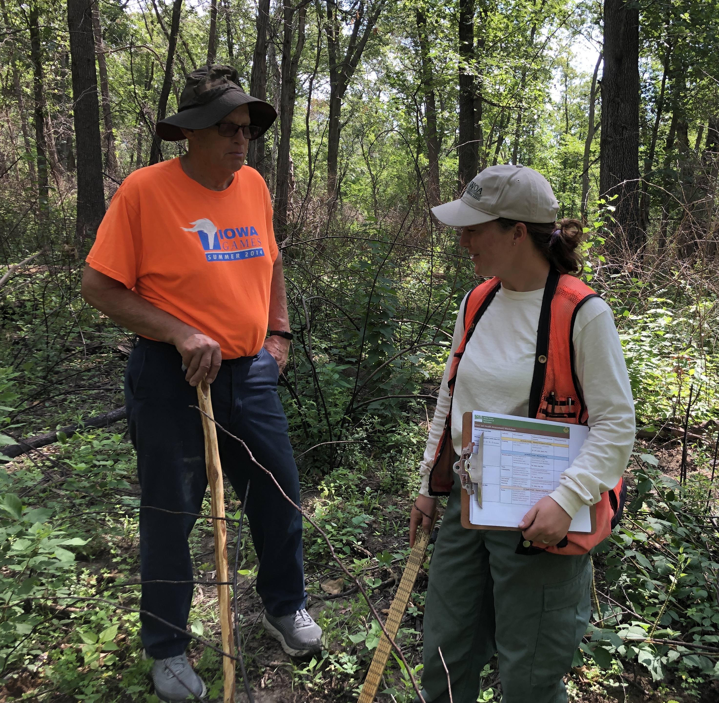
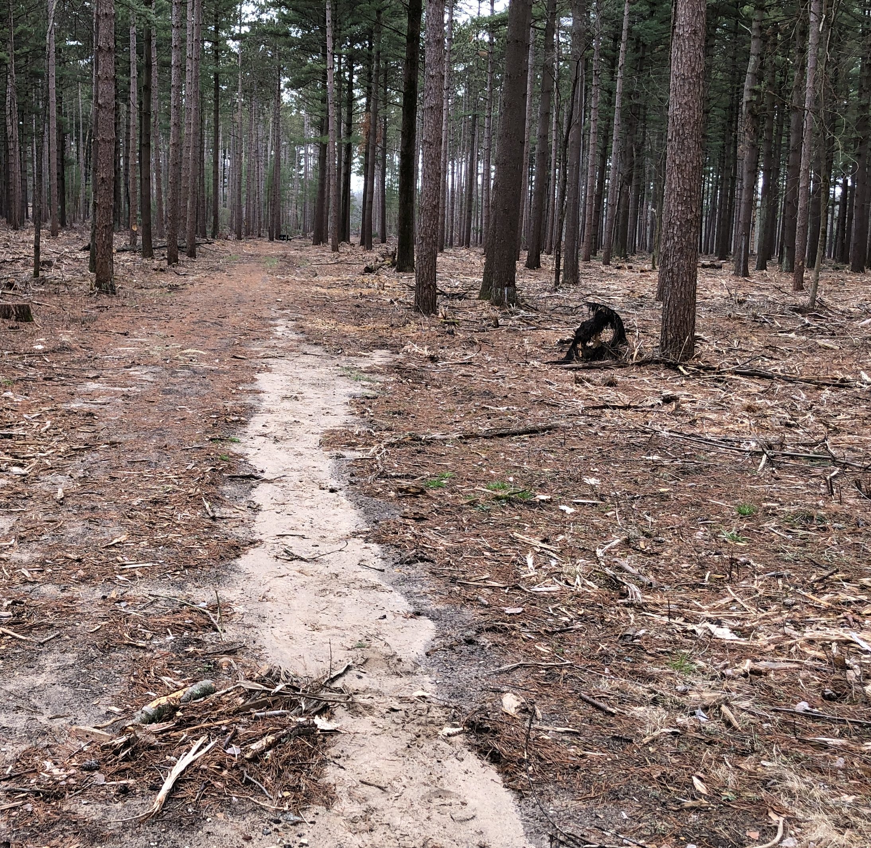

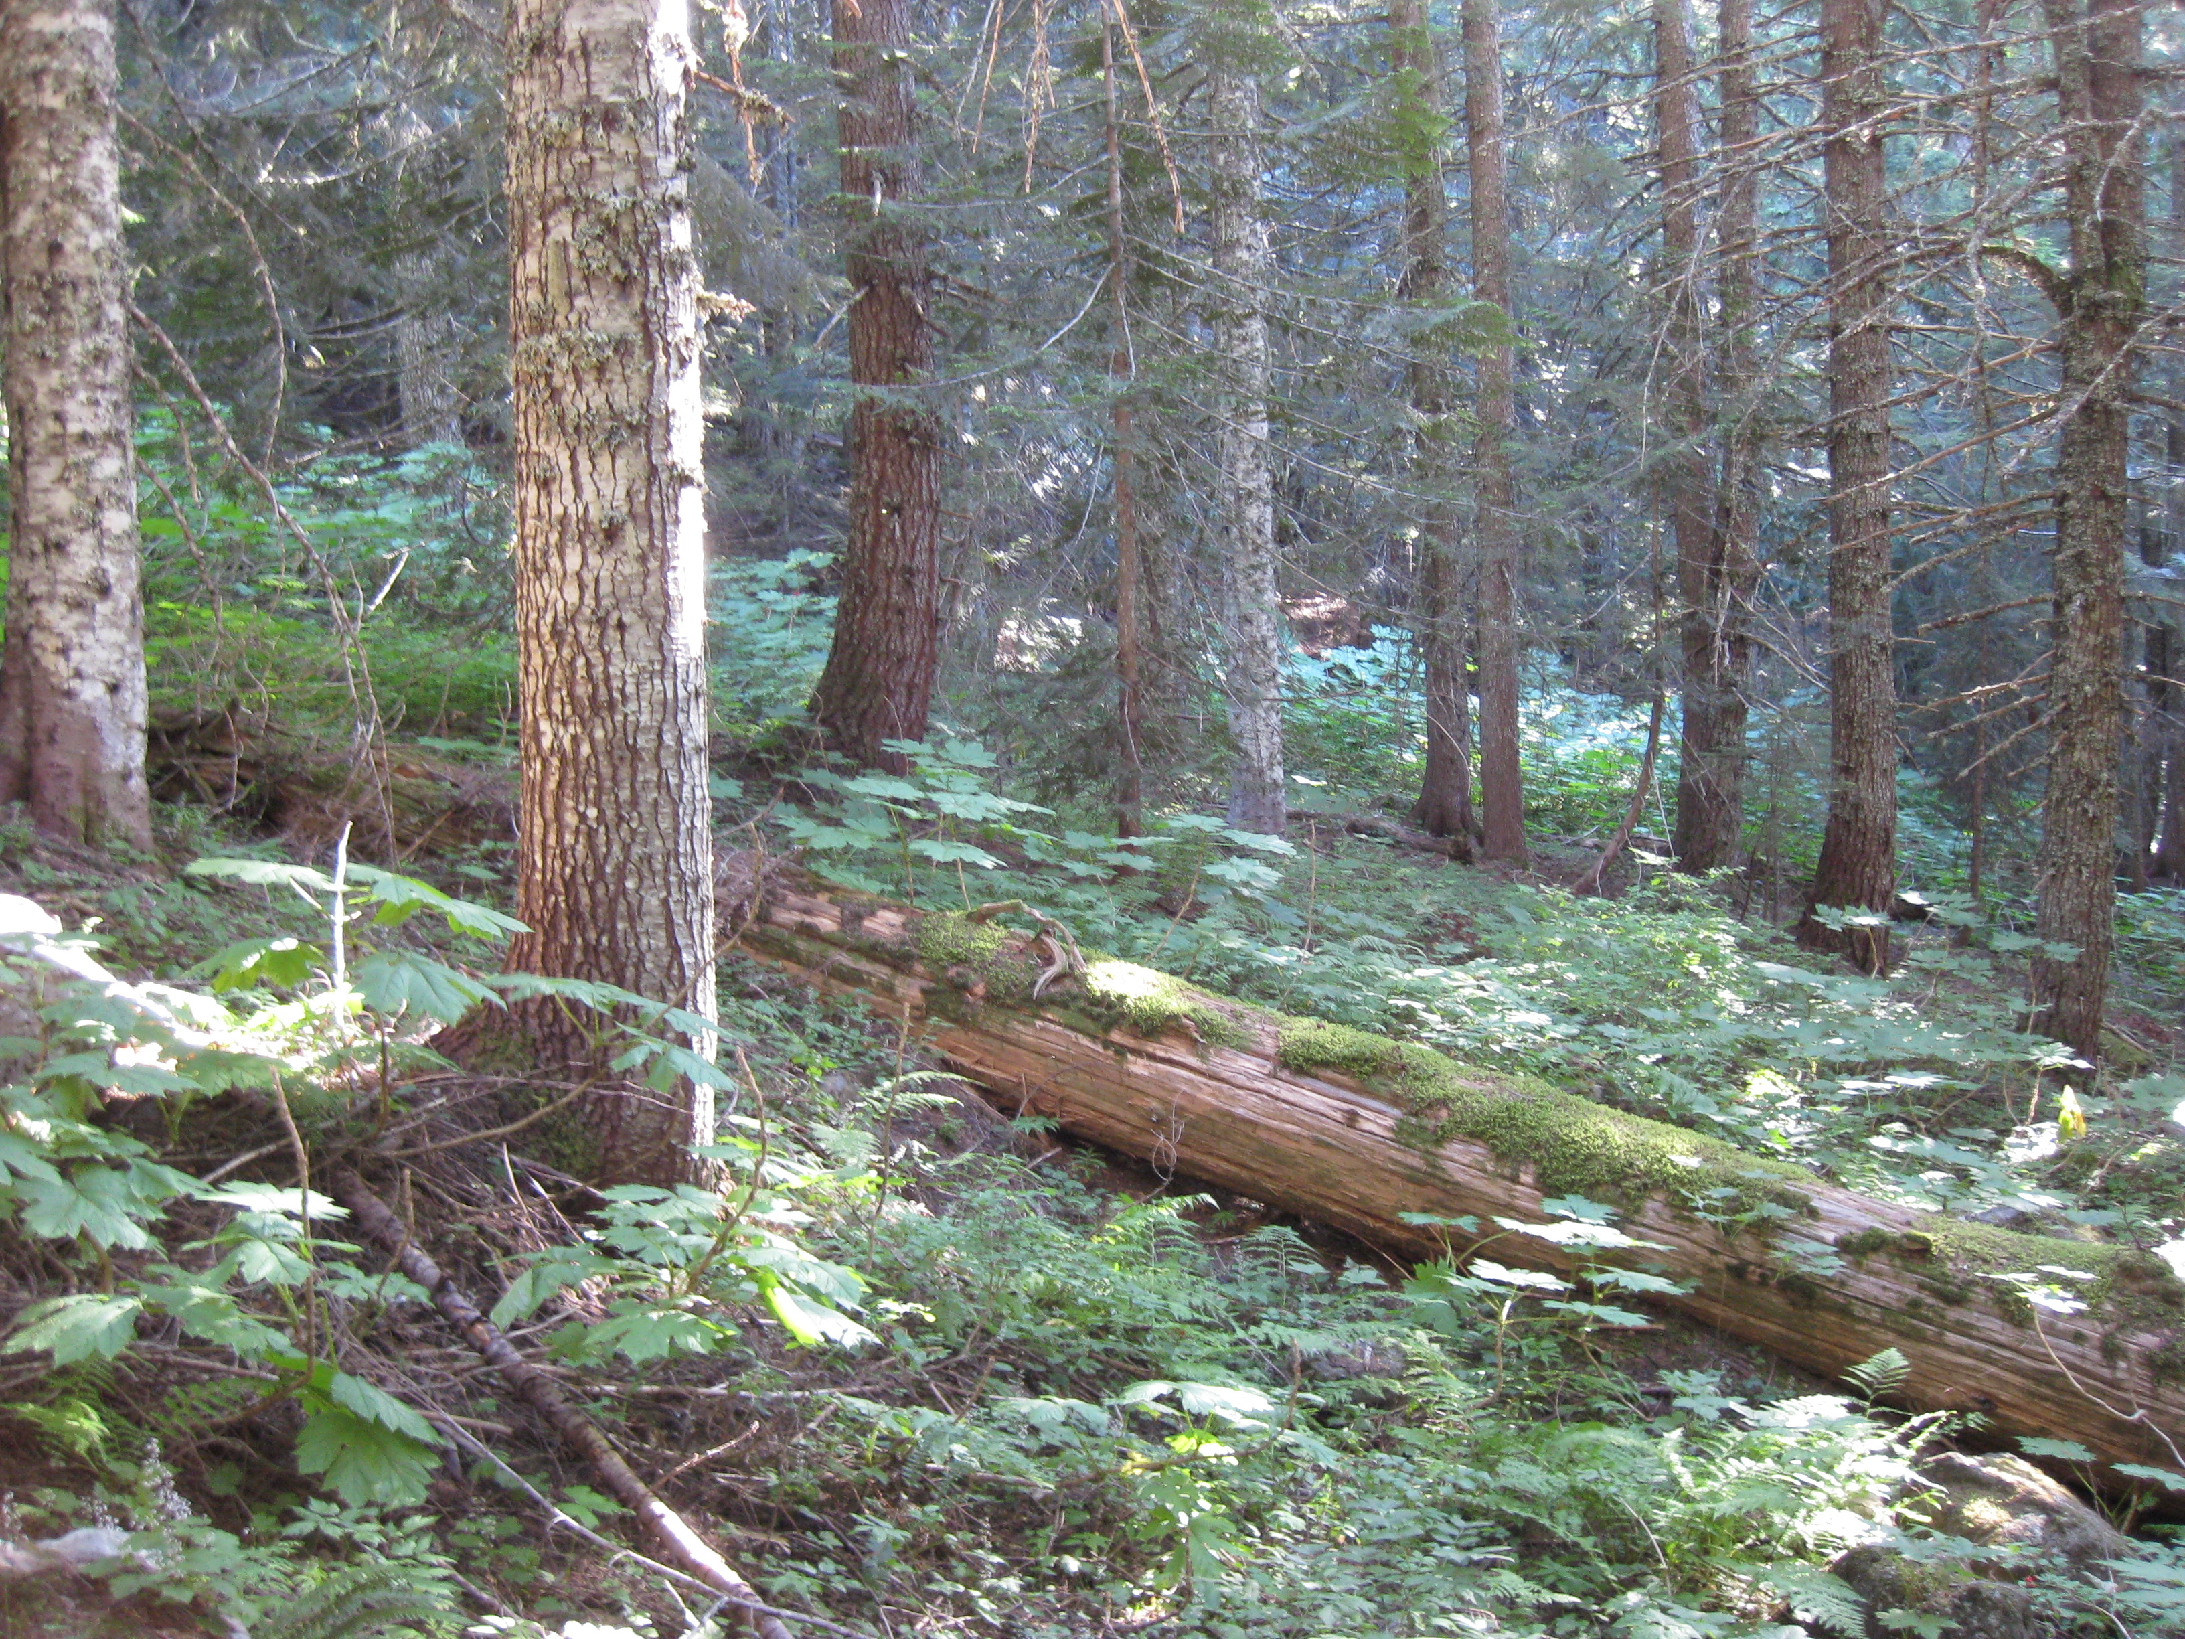
Introduction to
the Forestland
In-Field Soil Health Assessment (FIFSHA)
Notes:
Photo Credits: Tom Sauer
Top Right: Trail, Kettle Moraine State Forest, South Unit, Waukesha County, Wisconsin
Top Left: Private forest owner and tech service provider, Iowa
Bottom: Downed woody debris, Mount Hood National Forest, Oregon

Slide 2
Objective
Introduce the Forestland In-Field Soil Health Assessment (FIFSHA) tool
- Background
- Format
- Suggested procedures
- Example application
Notes:
The objective of this module is to provide an overview of the Forestland In-Field Soil Health Assessment (FIFSHA) tool.

Slide 3

FIFSHA
The goal of a Forestland In-Field Soil Health Assessment (FIFSHA)
is to identify soil health resource concerns (RCs) on private non-
industrial forestland agroecosystems.
Eight Indicators: To Identify Four Soil Health RCs:
  Soil Cover - Aggregate Instability (AGG)
  Woody Debris - Compaction (CPT)
  Soil Burn Severity - Soil Organism Habitat Loss
  Soil Disturbance Intensity or Degradation (HAB)
  Soil Structure - Organic Matter Depletion
  Water Stable Aggregates (SOM)
  Soil Fauna/Biological Diversity
  Roots
Notes:
Brief outline of Forestland In-Field Soil Health Assessment (FIFSHA). Eight indicators to assess whether any of the four soil health concerns are present.

Slide 4

FIFSHA
Rate RCs under each indicator as Likely Resource Concern(s),
Potential Resource Concern(s), or No Apparent Resource
Concern(s), assigning numerical values (1-5)
Notes:
Numerical indicator ratings are used to identify the likelihood of soil health resource concerns.

Slide 5
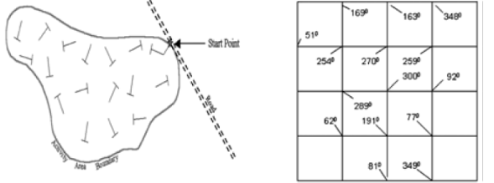
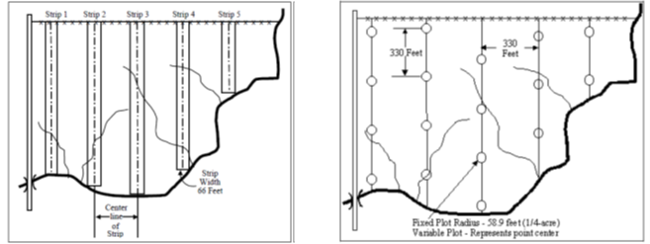
Where to Apply the FIFSHA
Multiple random transects or systematic grid points (Page-Dumroese et al., 2009; USFS soil disturbance protocol)
Strip sampling, fixed plot sampling or variable plot sampling as part of forest inventory (Natural Resources Conservation Service, 2004)
Notes:
Choosing sites for application of FIFSHA is key to accurate identification of soil health resource concerns. Find representative areas of sections of forest stand for application of conservation practices should soil health resource concerns be indicated.
Page-Dumroese, D. S., A. M. Abbott, and T. M. Rice. 2009. Forest soil disturbance monitoring protocol volume I: rapid assessment. U. S. Department of Agriculture, Forest Service. Gen. Tech. Report WO-82a. 31 p. https://doi.org/10.2737/WO-GTR-82A
Natural Resources Conservation Service, National Forestry Handbook, title 190, February 2004.

Slide 6
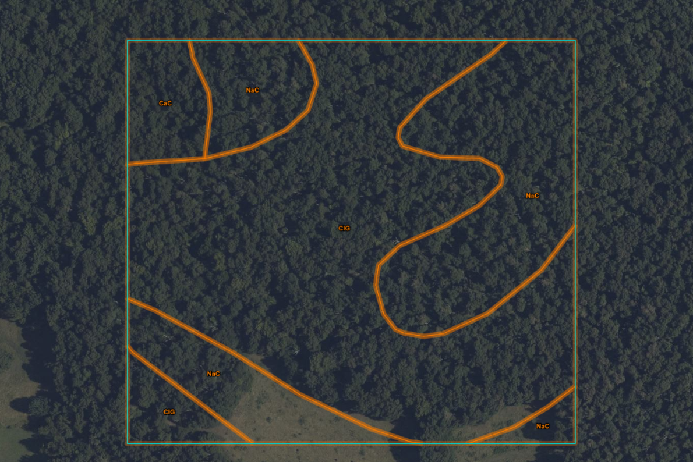
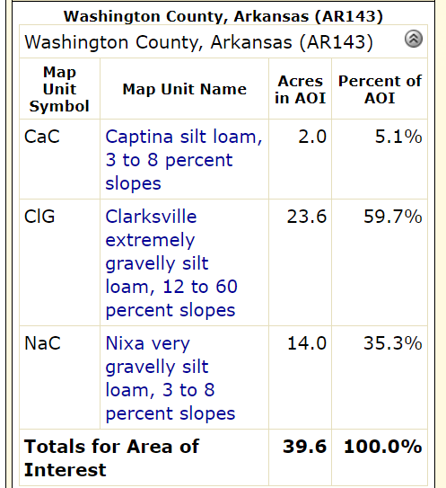
Site Selection
# Sites
1
9
1320’
6
16
Fixed plot sampling
1 assessment/ 2.5 acres
1320’
Notes:
Example fixed plot sampling pattern in a 40-acre tract located in Ozark Highlands (Washington County, Arkansas). Sampling pattern is representative of proportion of soil map units. This is a site with considerable variability in slope and aspect. All the soils have some amount of coarse fragment content, composed mainly of chert.

Slide 7
When to Apply the FIFSHA
Concurrent with forest inventory
Following forest practices or site disturbance
- weed or brush control
- precommercial or commercial thinning
- tree harvest
- insect infestation, pathogen outbreak, weather event
Following application of conservation practices
Avoid extreme conditions (drought, flood, extreme heat or cold)
If deciduous forest, after leaf drop or in spring with cool/moist soil
Notes:
There may be several reasons for a landowner wanting to complete a FIFSHA assessment. They may be concerned about the effects of a forestry practice or site disturbance and want to know whether there has been an impact on soil health. They may have already applied and conservation practice, either based on a FIFSHA assessment or other recommendation, and want to verify that the practice achieved its intended goal.
The planner will want to avoid extreme conditions that may not accurately represent typical conditions. Drought, flood, or extreme heat or cold conditions should be avoided to assure that these conditions don’t lead to anomalous results or interpretations.
As the litter layer in a deciduous forest may change over the seasons, planners may wish to avoid mid- to late-summer when the previous year’s leaf drop may be largely decomposed. Even if the soil cover is reduced, full tree and understory canopy cover should compensate by protecting the soil surface from raindrop impact. The timing in deciduous forests is less of a concern if there is an accumulations of leaf litter/O horizon present.

Slide 8
How to Apply the FIFSHA
Review landowner objective(s) and site history
Collect site information (soil series, slope, aspect, ESD…) & assemble materials (maps, shovel, tape measure, camera)
Develop site selection strategy (# and locations). At each site:
- Visually estimate Soil Cover, Woody Debris, Soil Burn Severity,
and Soil Disturbance Intensity in 52.6’ diameter area (1/20 A)
- Dig 1 - 3 holes with shovel, noting resistance to insertion
- Assess Soil Structure, Water Stable Aggregates, and Roots
- Observe Soil Fauna/Biological Diversity in soil, litter, and
beneath woody debris
Record ratings on worksheets and review scores to determine if there are any soil health RCs
Notes:
The FIFSHA assessment should acknowledge the landowner’s objectives for the stand and the history of the site management as it affects current conditions. By collecting the site information beforehand, the planner will have a better idea of what conditions to expect and what reference state conditions might look like. This will help them assign ratings for the indicators based on the site potential.
The sampling strategy may be a challenging aspect of the assessment. If a forest inventory is being completed, a FIFSHA assessment could be included on a proportion of the inventory sites. This may be ideal as having stand and soil health information for the same locations and at the same time should aid in interpreting any linkages between stand characteristics and soil health.
Greater detail is provided in later slides about rating each indicator. An overview is presented here where 4 indicators are visually assessed over a 1/20 acre area and 1 to 3 holes are dug with a shovel or spade to assess the remaining indicators in the surface ~12” of soil. Soil fauna may also be observed in the litter and beneath woody debris.
Ratings can be recording directly in the spreadsheet if a tablet or laptop are available, otherwise, the ratings can be recorded on paper copies of the assessment worksheets.

Slide 9
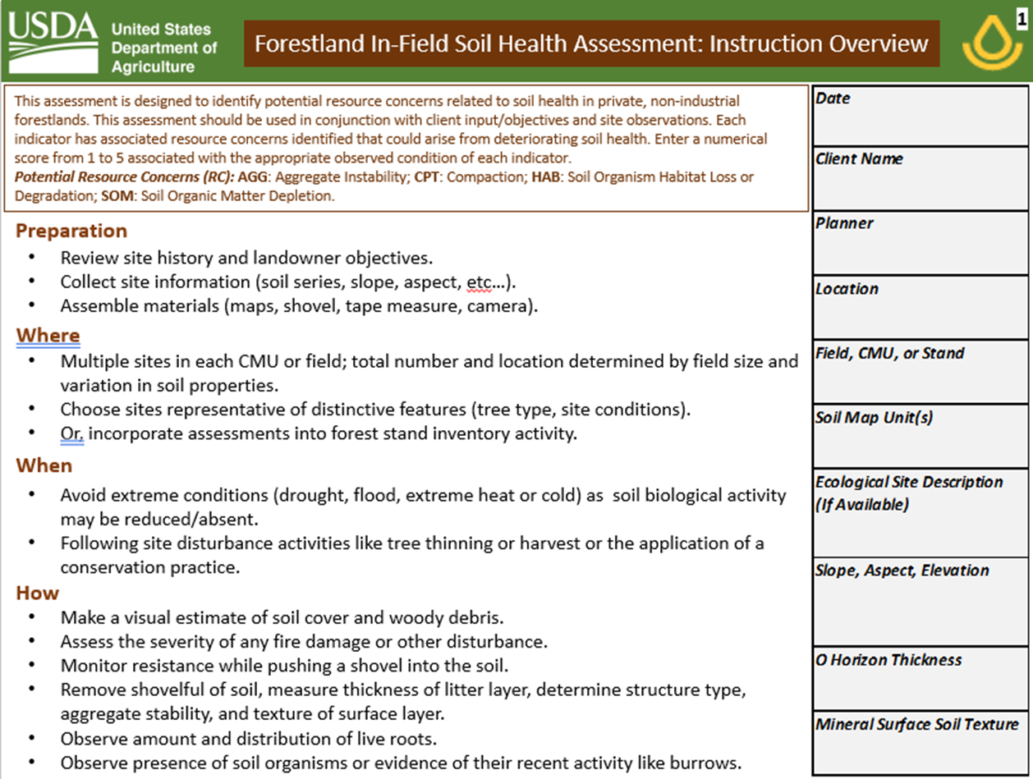
FIFSHA
Cover Sheet
Notes:
The FIFSHA cover sheet provides a brief summary of the steps in conducting an assessment and space to record site details.

Slide 10
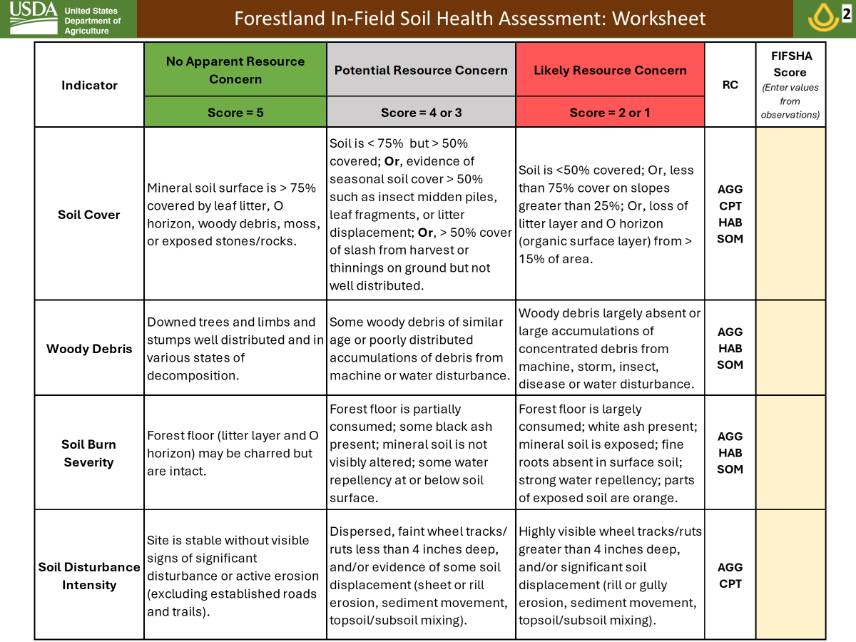
FIFSHA
Page 2
Notes:
Page 2 of the FIFSHA lists the first four indicators that are visually assessed by observation of a 52.6’ diameter (1/20 acre) area of the forest floor.
In addition to a description of the different rating categories, the soil health RCs associated with each indicator are listed.
A score from 1 to 5 is entered to each indicator, based on the visual assessment.

Slide 11
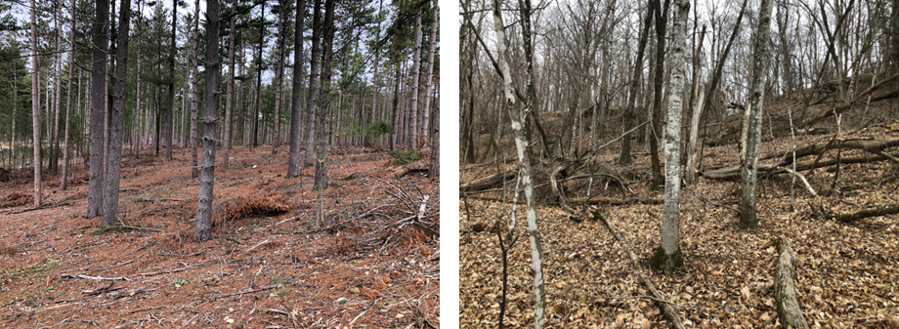
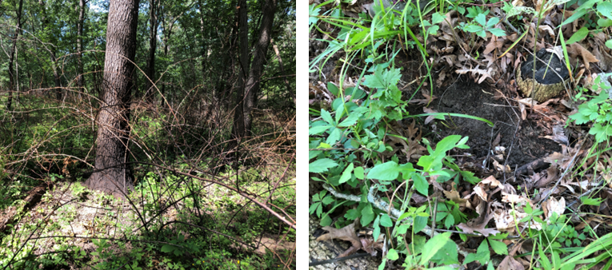
Applying the FIFSHA
Unobstructed View
– Rotate 360°
1/20 acre (52.6’ diameter circle)
Obstructed View
Walk within circle
Clear vegetation
to observe forest
floor
Notes:
Some examples of what FIFSHA assessment sites might look like. Top Left, pine plantation; Top Right, natural broadleaf stand; Bottom Left, hardwood stand after prescribed burn with bramble and herbaceous plants; Bottom Right, same hardwood stand with soil exposed. Photo credits: Tom Sauer
If the planner has an unobstructed view, the surface indicators can be assessed by rotating around. If the view is obstructed, the planner may need to walk in a small circle withing the assessment area to visually assess the indicators.

Slide 12
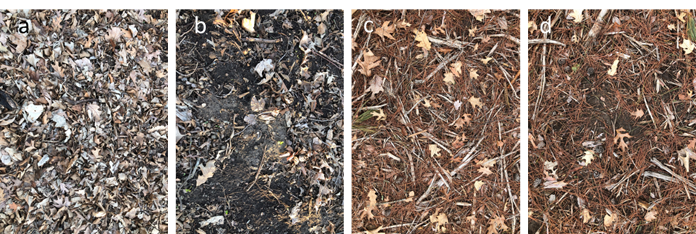
Soil Cover Indicator
Examples of forest soil cover: broadleaf cover of near 100% (a), broadleaf litter and moss < 50% cover (b), pine litter of 100% cover (c), and pine litter of ~75% cover (d).
Notes:
Soil Cover Indicator narratives and examples of broadleaf and pine litter cover. Photo credits: Tom Sauer

Slide 13
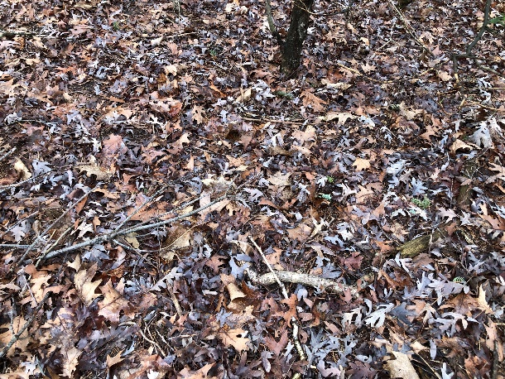
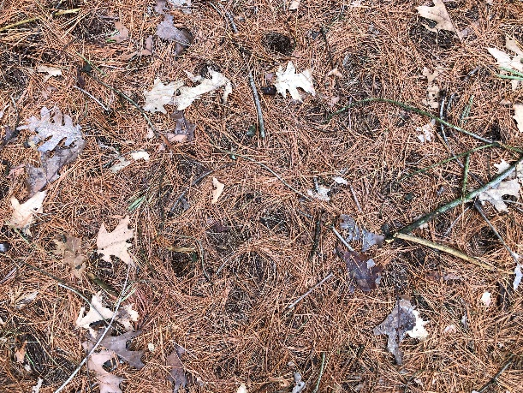
Temperate Deciduous vs Coniferous Litter
Deciduous
Coniferous
Most leaves drop in fall (some carry leaves through winter)
Litterfall: 5.5 t ha⁻¹ yr⁻¹ (2.4 T/A/yr)
Forest floor: 18 t ha⁻¹ (8 T/A) Mull type (mixed organic/mineral, bacterial decomposition, granular)
Turnover rate: 4 yrs.
Periods or continuous partial needle drop (10-50% / year)
Litterfall: 3.5 t ha⁻¹ yr⁻¹ (1.6 T/A/yr)
Forest floor: 45 t ha⁻¹ (20 T/A) Mor type (matted, undecayed, low pH, fungal decomposition, distinct boundary)
Turnover rate: 15 yrs. (high C/N, lignin/N)
Adams et al., 2019. https://doi.org/10.1016/B978-0-444-63998-1.00006-9
Notes:
Deciduous and coniferous forests have litter layers with different characteristics. In general, deciduous forests have larger annual litterfall but a smaller litter layer because the leaves are more easily decomposed than the needles from coniferous trees. Coniferous trees drop 10 to 50% of their needles each year and when the needles drop depends on the species. The needles have a high C/N ratio and lignin content so they decompose more slowly than deciduous leaves. For these reasons, coniferous forests tend to have a thick litter layer.
Adams, M. B., C. Kelly, J. Kabrick, and J. Schuler. 2019. Temperate forests and soils. pp. 83-108 In: Global Change and Forest Soils https://doi.org/10.1016/B978-0-444-63998-1.00006-9.
Pine needle drop p. 58:
Kozlowski, T. T. and S. G. Pallardy. 1997. Physiology of Woody Plants. 2nd Ed. Academic Press, New York. 411 pp.
Berg, B. and R. Laskowski 2006. Litter Decomposition: A guide to carbon and nutrient turnover. Academic Press. 421 pp.
Photo credits: Tom Sauer

Slide 14
The Forest Floor
Repository of organic inputs from leaves, twigs, branches
- decomposition and mixing of these inputs by soil biota
build SOM
Habitat for forest and soil biota
Moderates soil moisture and temperature regimes
  - helps sustain warm and moist environment optimal for
  biological activity
Some protection of surface roots from compaction by equipment or
animals
Notes:
The forest floor can also be called the O horizon (“O” for organic) and is a distinctive characteristic of forest soils. The litter layer links aboveground plant processes with soil processes. Loss of the litter layer by erosion or fire leaves the soil surface exposed, greatly restricts soil biota, and leads to greater extremes in soil moisture and temperature.

Slide 15
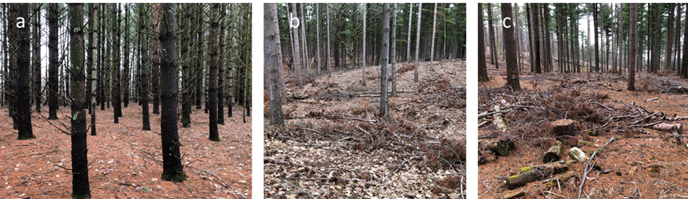
Woody Debris Indicator
Examples of coarse woody debris (CWD): very limited CWD in a pine plantation (a), distributed, moderate amounts of pine CWD (b), and slash from pine harvest, poorly distributed (c).
Notes:
Coarse woody debris (CWD) is an element of Soil Cover so there is interplay between the indicators. Sites with low litter cover may have high CWD and vice versa. CWD can be thought of as more slowly decomposing litter but it also provides important habitat to different soil biota than are found in leaf litter.
.
Photo credits: Tom Sauer

Slide 16
Coarse Woody Debris (CWD)
Snags and stubs
CWD
Maser et al., 1979. https://research.fs.usda.gov/treesearch/6630
Notes:
Maser, C., R. G. Anderson, K. Cromack, Jr., J. T. Williams, and R. E. Martin. 1979. Dead and down woody material. pp. 78-95 In: J. W. Thomas (Ed.) Wildlife Habitats in Managed Forests: the Blue Mountains of Oregon and Washington. Agriculture Handbook No. 553. U. S. Department of Agriculture Forest Service.
Snags = standing dead trees
Stubs = broken off standing dead trees
Coarse woody debris = material laying on forest floor
Some CWD naturally occurs in forest stands due to death of old trees or damage from wind, disease or pests. CWD is very important for soil biota as the larger woody material provides habitat for organisms over a long period of time.

Slide 17
Coarse Woody Debris
> 10 cm (3.9”) diameter and > 1 m (3.3 ft.) long on the soil surface
Can be continuous (well-distributed) or concentrated (slash)
Provides habitat and foraging areas for invertebrates, reptiles,
birds, and small mammals & substrate for insects, fungi, lichen,
and mosses, providing a food source for wildlife
Decomposition replenishes soil nutrients and provides a source of C
Serve as “nurse logs” for tree seedlings and other plants
Maser et al., 1979. https://research.fs.usda.gov/treesearch/6630
Notes:
Slash is woody material left in the forest after harvest or thinning operations. Slash is managed in different ways and there are regional variations in slash management. In drier regions, slash represents a fire threat so it may be piled and preemptively burned. Due to concerns for smoke and the loss of carbon and nutrients, burning is being discouraged and other methods for dealing with slash are being encouraged.
Maser, C., R. G. Anderson, K. Cromack, Jr., J. T. Williams, and R. E. Martin. 1979. Dead and down woody material. pp. 78-95 In: J. W. Thomas (Ed.) Wildlife Habitats in Managed Forests: the Blue Mountains of Oregon and Washington. Agriculture Handbook No. 553. U. S. Department of Agriculture Forest Service.

Slide 18
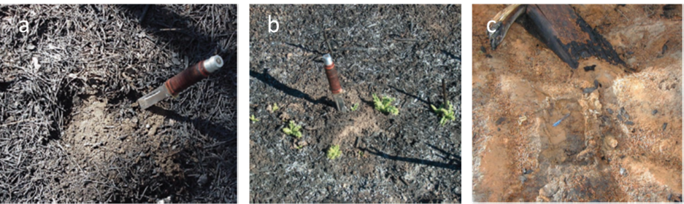
Soil Burn Severity Indicator
Examples of low burn severity with charred needles that are still intact (a), moderate burn severity with majority of litter consumed (b), and high burn severity with thick ash layer and oxidized soil (c). Photo credits: Parsons et al., (2010). https://doi.org/10.2737/RMRS-GTR-243
Notes:
It is important to emphasize that prescribed fire is intended to be at a lower temperature and for a shorter duration that does not cause significant damage to the surface soil. Although some loss of the litter layer may occur, the benefits for overall forest health offset this loss by improving forest productivity.
Certini, G. 2005. Effects of fire on properties of forest soils: a review. Oecologia 143:1-10. https://doi:10.1007/s00442-004-1788-8
Mataix-Solera, J., A. Cerda, V. Arcenegui, A. Jordan, and L. M. Zavala. 2011. Fire effects on soil aggregation: A review. Earth-Science Reviews 109:44-60. doi:10.1016/j.earscirev.2011.08.002

Slide 19
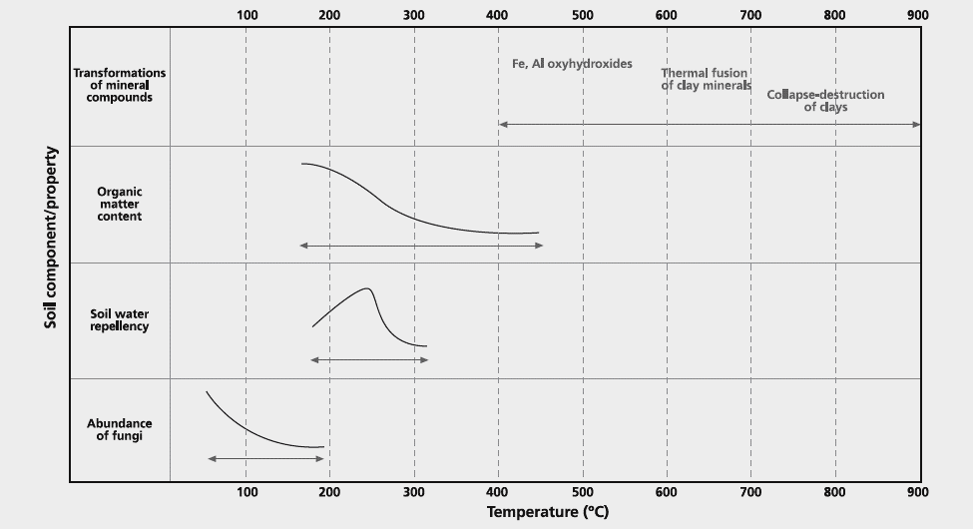
Fire Effects on Soil Properties
Surface Temperature
Light
Moderate
High
60 °C (140 °F) lethal threshold for plant roots
Prescribed Fire
Certini, 2005. https://doi:10.1007/s00442-004-1788-8
Mataix-Solera et al., 2011. https://doi:10.1016/j.earscirev.2011.08.002
Notes:
Certini, G. 2005. Effects of fire on properties of forest soils: a review. Oecologia 143:1-10. https://doi:10.1007/s00442-004-1788-8
Mataix-Solera, J., A. Cerda, V. Arcenegui, A. Jordan, and L. M. Zavala. 2011. Fire effects on soil aggregation: A review. Earth-Science Reviews 109:44-60. doi:10.1016/j.earscirev.2011.08.002
Erosion and compaction also change/destroy soil aggregates.
Important to stress that the prescribed fire practice, when properly applied, has limited negative effects on soil health.

Slide 20
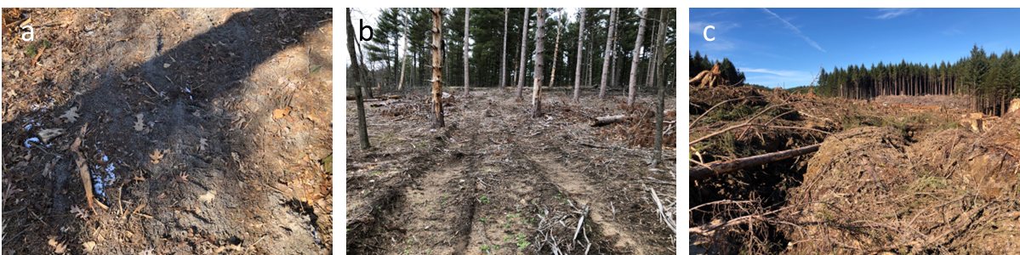
Soil Disturbance Intensity Indicator
Examples of low disturbance intensity with faint tracks following mastication of invasive understory woody species with a tracked skid steer (a), moderate disturbance intensity of shallow wheel tracks (b), and deep ruts from harvest equipment indicating severe disturbance (c).
Notes:
Although the examples are for mechanical disturbance, recent or legacy erosion (e.g., degraded cropland converted to forest) is also a soil disturbance, in some instance a severe disturbance.
Photo Credits: Left and middle, Tom Sauer, Right, Dennis Landwehr, USFS, retired.

Slide 21
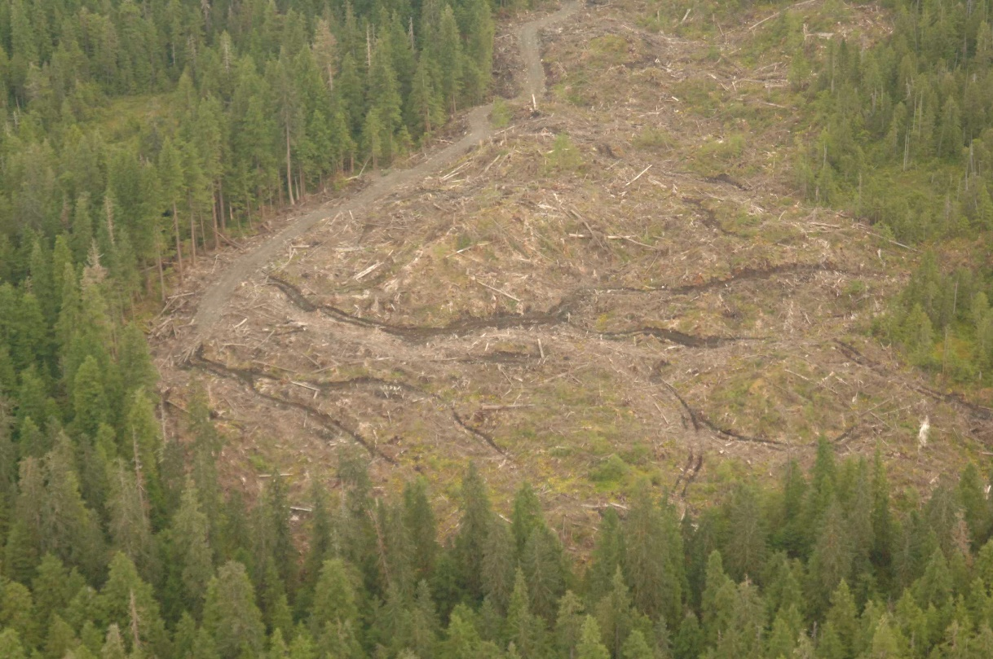
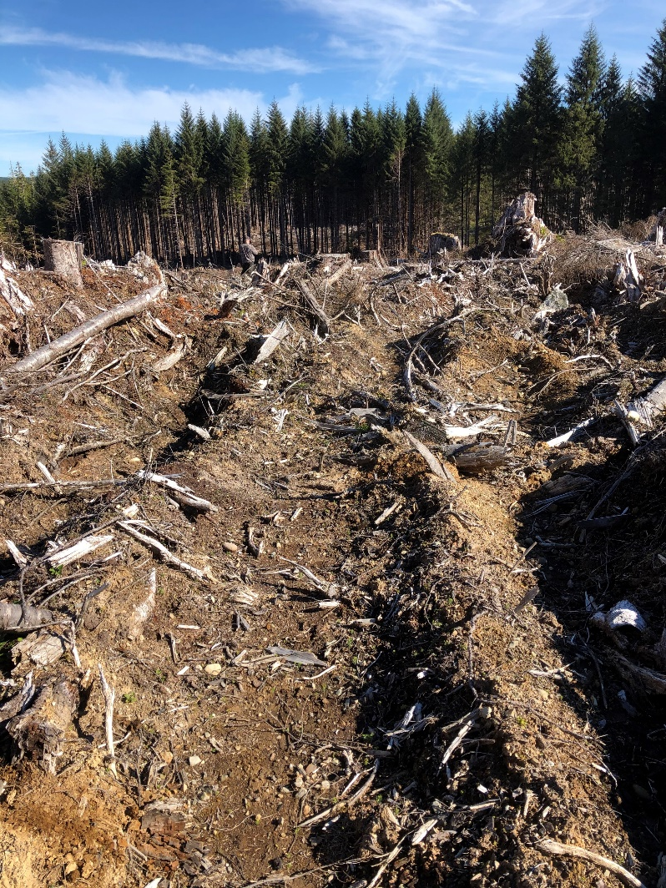
Forest Soil Disturbance Examples
May include legacy or recent erosion
Locations:
Impacts:
Roads
Skid Trails
Landings
Compaction
Ruts
Scalping
Photo Credits: Dennis Landwehr,
U.S. Forest Service, Retired
Cambi et al., 2015. https://doi.org/10.1016/j.foreco.2014.11.022
Crawford et al., 2021. https://doi.org/10.2737/RMRS-GTR-421
Notes:
Improvements in equipment (e.g., tracked vehicles) , management practices, and the timing of practices (e.g., harvest in winter with frozen soils) can greatly reduce disturbance impacts but, as these recent photos show, severe disturbance can still occur.
Cambi, M., G. Certini, F. Neri, and E. Marchi. 2015. The impact of heavy traffic on forest soils: A review. Forest Ecology and Management 338:124-138. https://doi.org/10.1016/j.foreco.2014.11.022
Crawford, Leslee J.; Heinse, Robert; Kimsey, Mark J.; Page-Dumroese, Deborah S. 2021. Soil sustainability and harvest operations: A review. Gen. Tech. Rep. RMRS-GTR-421. Fort Collins, CO: U.S. Department of Agriculture, Forest Service, Rocky Mountain Research Station. 39 p. https://doi.org/10.2737/RMRS-GTR-421

Slide 22
Forest Soil Disturbance
Physical soil disturbance by soil compaction, rutting, and scalping
(litter and surface soil) can be infrequent but severe with potentially
long-term effects
Especially (but not limited to) roads, skid trails, and landings
Modern forestry equipment and practice guidelines (e.g., harvest
when soil is frozen) can reduce or avoid most impacts
Livestock trails may also lead to compaction and rutting
May include impacts from legacy or recent soil erosion
Cambi et al., 2015. https://doi.org/10.1016/j.foreco.2014.11.022
Crawford et al., 2021. https://doi.org/10.2737/RMRS-GTR-421
Notes:
Activities that lead to disturbance may be infrequent but can also be severe, taking years for the soil to recover.
Cambi, M., G. Certini, F. Neri, and E. Marchi. 2015. The impact of heavy traffic on forest soils: A review. Forest Ecology and Management 338:124-138. https://doi.org/10.1016/j.foreco.2014.11.022
Crawford, Leslee J.; Heinse, Robert; Kimsey, Mark J.; Page-Dumroese, Deborah S. 2021. Soil sustainability and harvest operations: A review. Gen. Tech. Rep. RMRS-GTR-421. Fort Collins, CO: U.S. Department of Agriculture, Forest Service, Rocky Mountain Research Station. 39 p. https://doi.org/10.2737/RMRS-GTR-421

Slide 23
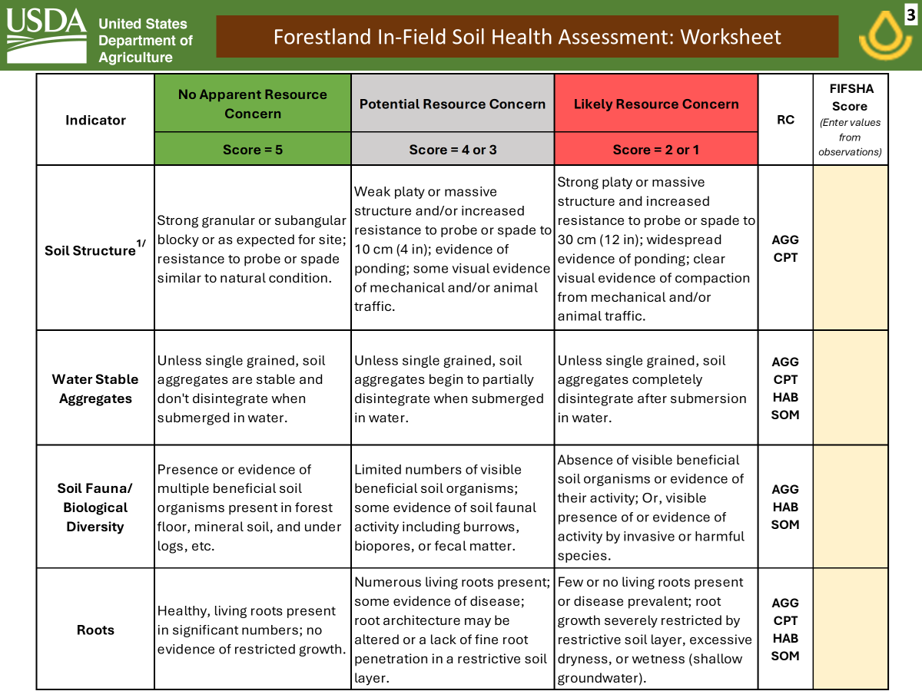
FIFSHA
Page 3
^{1/} Soil Structure Indicator note: If the soil survey confirms a natural platy structure anywhere within the upper 30 cm (12 in), and there is no other indication of human-induced compaction, please enter a FIFSHA Score of 5 for this indicator.
Notes:
Page 3 of the FIFSHA has four more indicators to rate after removing a soil block. Note the footnote regarding the Soil Structure indicator. If there is natural platy structure and no evidence of human-induced compaction, then a rating of 5 should be entered.

Slide 24
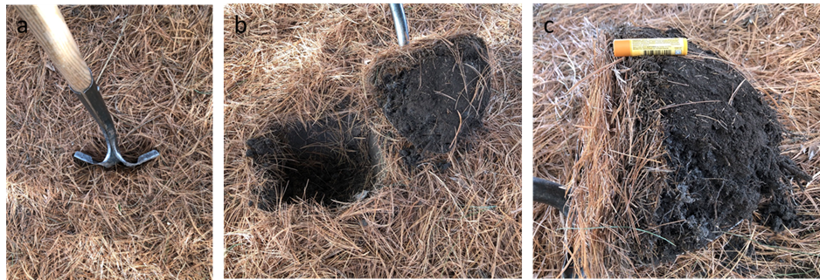
Applying the FIFSHA – Exposing Soil
Photo of shovel in soil in a pine planting (a), the soil removed (b) and a closeup of the litter layer and roots in the soil (c).
Dig 1 – 3 holes at each FIFSHA assessment site to rate RCs for the Soil Structure, Water Stable Aggregates, Soil Fauna/Biological Diversity, and Roots indicators.
Notes:
An example of exposing a soil block for a FIFSHA assessment of the last four indicators (Soil Structure, Water Stable Aggregates, Soil Fauna/Biological Diversity, and Roots).
Photo credits: Tom Sauer

Slide 25
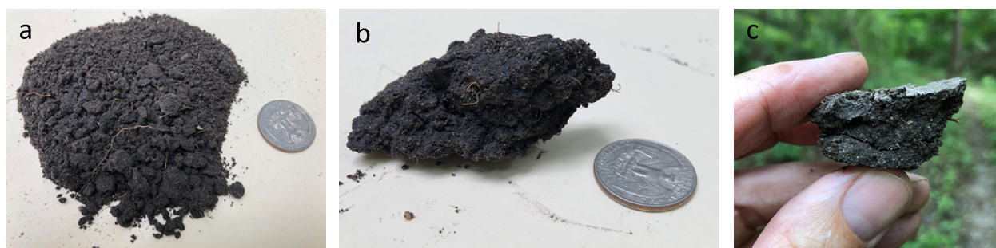
Soil Structure Indicator
^{1/} Soil Structure Indicator note: If the soil survey confirms a natural platy structure anywhere within the upper 30 cm (12 in), and there is no other indication of human-induced compaction, please enter a FIFSHA Score of 5 for this indicator.
Granular soil structure (a), subangular blocky soil structure (b), and weak platy structure (c). All photos are of soil taken from the A horizon of a hardwood forest soil.
Notes:
Soil structure is the shape of soil aggregates. Granular structure at the soil surface and subangular blocky structure below are typical of good soil structure although there may be variation by soil type. For instance, sandy soils may naturally have weak granular structure due their texture, while heavy clay soils may have strong angular structure.
This indicator is really targeting evidence of compaction as observed by platy structure of massive soil conditions that relate to poor air and water movement and restrictions on root growth.
Photo credits: Tom Sauer

Slide 26
Soil Structure
https://www.nrcs.usda.gov/resources/guides-and-instructions/field-book-for-describing-and-sampling-soils
Notes:
Soils naturally have different structure based on inherent properties like texture and parent material. The field book provides examples and techniques for identifying different forms of structure in field soils. Some soils have natural platy structure but platy structure can also be indicative of compaction. Soils with platy or are massive (structureless) are more likely to have poor aeration, infiltration, and rooting potential.
Schoeneberger, P.J., D.A. Wysocki, E.C. Benham, and Soil Survey Staff. 2012. Field book for describing and sampling soils, Version 3.0. Natural Resources Conservation Service, National Soil Survey Center, Lincoln, NE. https://www.nrcs.usda.gov/resources/guides-and-instructions/field-book-for-describing-and-sampling-soils

Slide 27
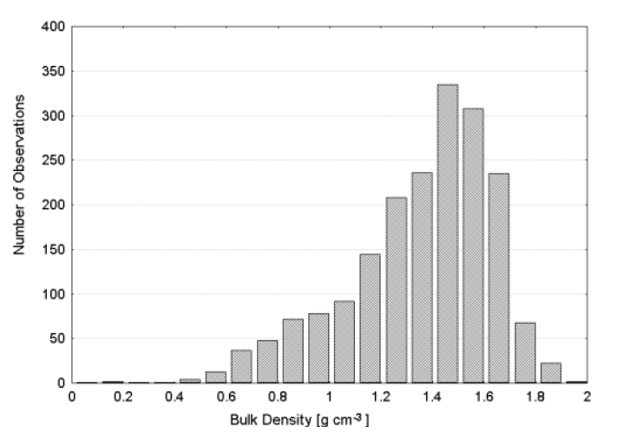
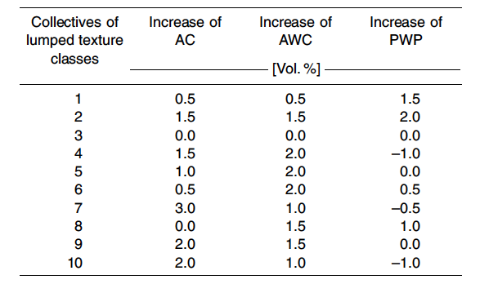
Forest Soil Bulk Density & Available Water
% Increase for Each 1% Increase in SOC
Forest Soils: 58% < 1.45
Ag Soils: 27% < 1.45
sand
silt
clay
AC = Air Capacity (0 to -6 kPa)
AWC = Available Water Capacity (-6 to -1600 kPa)
PWP = Permanent Wilting Point (ψ = -1600 kPa)
Water retention curves are different for forest soils compared to agricultural soils primarily due to lower bulk densities and a greater effect of increased SOC on water storage near field capacity.
Teepe et al., 2003. https://doi.org/10.1002/jpln.200390001
Notes:
This information comes from a very large database and compares properties of crop and forest soils. Water retention is an important soil property as ability to sustain plant growth during dry/drought conditions is critical to maintaining productivity and soil health. The data show that forest soils, because they have lower bulk density, are able to store more soil water with each incremental increase in soil organic carbon. Thus, forest soils with high SOM are more likely to sustain tree growth under dry conditions.
Teepe, R., H. Dilling, and F. Beese. 2003. Estimating water retention curves of forest soils from soil texture and bulk density. Journal of Plant Nutrition and Soil Science 166:111-119. https://doi.org/10.1002/jpln.200390001

Slide 28
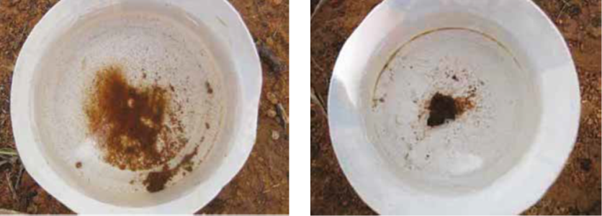
Water Stable Aggregates Indicator
Soil aggregate that disintegrated after placing in water (left) and an aggregate that remained stable (right). Photo credits: Pellant et al., 2020.
Notes:
The AGG resource concern is the only soil health RC that is included in all FIFSHA indicators. This highlights the importance of soil aggregation for soil health.
Since there are multiple tests for aggregate stability, the FIFSHA provides guidance for three of the common methods so planner can use a test that is familiar to them. The bottle cap test is the simplest test for aggregate stability, but the FIFSHA also supports the sink strainer and slake tests.
Pellant, M., P. L. Shaver, D. A. Pyke, J. E. Herrick, N. Lepak, G. Riegel, E. Kachergis, B. A. Newingham, D. Toledo, and F. E. Busby. 2020. Interpreting Indicators of Rangeland Health, Version 5. Tech Ref 1734-6. U.S. Department of the Interior, Bureau of Land Management, National Operations Center, Denver, CO. https://pubs.er.usgs.gov/publication/70215720

Slide 29
Soil Stability Bottle Cap Test
2 - 4 dry aggregates from multiple depths in the soil
FIFSHA
1 - 2
3 - 4
5
Pellant et al., 2020. https://pubs.er.usgs.gov/publication/70215720
Notes:
The bottle cap test is from the Interpreting Indicators of Rangeland Health (IIRH) and is a relatively simple method to assess aggregate stability. Small aggregates are placed in water in a bottle cap and how fast the aggregates disintegrate is used to assess their relative stability. Scoring for the FIFSHA is slightly different than for the IIRH. This technique is more commonly used in the western U.S.
Pellant, M., P. L. Shaver, D. A. Pyke, J. E. Herrick, N. Lepak, G. Riegel, E. Kachergis, B. A. Newingham, D. Toledo, and F. E. Busby. 2020. Interpreting Indicators of Rangeland Health, Version 5. Tech Ref 1734-6. U.S. Department of the Interior, Bureau of Land Management, National Operations Center, Denver, CO. https://pubs.er.usgs.gov/publication/70215720

Slide 30
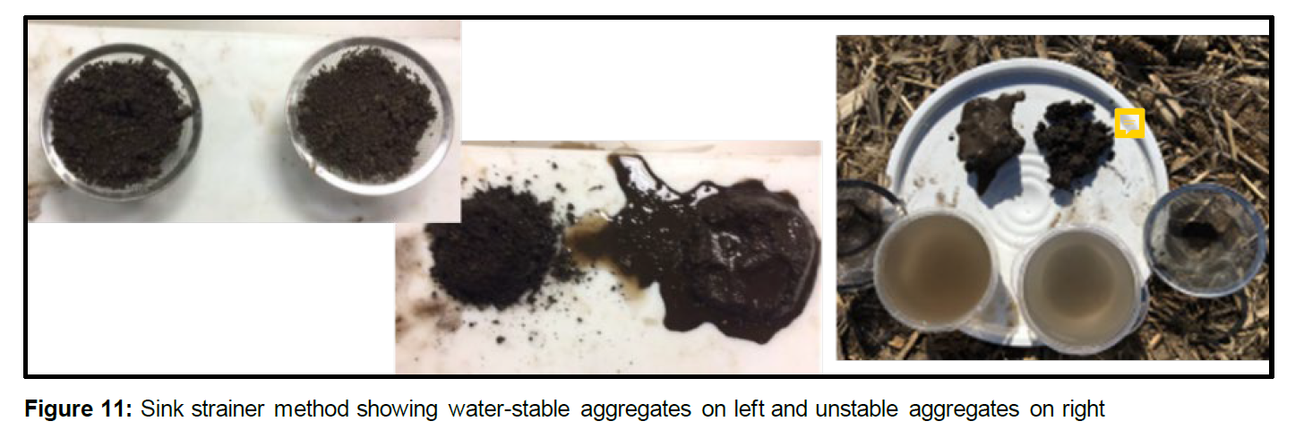
Sink Strainer Method
Place 2 – 4 small peds from multiple depths in sink strainer or small wire colander and immerse in a bowl of water to saturate
Turn strainer upside down on a flat surface
FIFSHA Scoring: No slaking = 5; partial slaking = 3-4; complete slaking = 1-2
USDA, 2020. Cropland In-Field Soil Health Assessment Guide. Soil Health Technical Note No. 450-06. U.S. Department of Agriculture, Natural Resources Conservation Service. Washington, D.C.
Notes:
The sink strainer method is more typical of temperate zones and cropping system soils. A larger sample/aggregate can be used than either the bottle cap or slake test (next slide).
USDA, 2020. Cropland In-Field Soil Health Assessment Guide. Soil Health Technical Note No. 450-06. U.S. Department of Agriculture, Natural Resources Conservation Service. Washington, D.C.

Slide 31
Slake Test
Collect 2 – 4 ~ 1 cm-diameter soil aggregates from multiple soil depths, air dry
Fill box with water to a depth of ~ 2 cm.
Place soil aggregate in sieve basket, immerse in water, and observe for 5 minutes
Dunk basket in and out of water 5 times and record ratings (next slide)
Repeat for all aggregates
Herrick et al., 2001. https://doi.org/10.1016/S0341-8162(00)00173-9
USDA, 2001. Soil Quality Test Kit Guide. U.S. Department of Agriculture, Natural Resources Conservation Service. Washington, D.C.
Notes:
This technique is also applicable if soils in the field are not dry so samples are brought back to the lab/office to air dry and then proceed with a slake test.
Herrick, J. E., W. G. Whitford, A. G. de Soyza, J. W. Van Zee, K. M. Havstad, C. A. Seybold, and M. Walton. 2001. Field soil aggregate stability kit for soil quality rangeland health evaluations. Catena 44:27-35. https://doi.org/10.1016/S0341-8162(00)00173-9
USDA, 2001. Soil Quality Test Kit Guide. U.S. Department of Agriculture, Natural Resources Conservation Service. Washington, D.C.

Slide 32
Slake Test Scoring
FIFSHA
1 - 2
3 - 4
5
USDA, 2001. Soil Quality Test Kit Guide. U.S. Department of Agriculture, Natural Resources Conservation Service. Washington, D.C.
Notes:
Scoring for the slake test in the FIFSHA is different than that used for the soil quality test kit.
Herrick, J. E., W. G. Whitford, A. G. de Soyza, J. W. Van Zee, K. M. Havstad, C. A. Seybold, and M. Walton. 2001. Field soil aggregate stability kit for soil quality rangeland health evaluations. Catena 44:27-35. https://doi.org/10.1016/S0341-8162(00)00173-9
USDA, 2001. Soil Quality Test Kit Guide. U.S. Department of Agriculture, Natural Resources Conservation Service. Washington, D.C.

Slide 33
Water Stable Aggregates
Soil structure classification is based on the shape of the soil aggregates, affected by soil forming processes, texture, and management
Aggregate stability is a measure of how soil aggregates resist crumbling or disintegrating
Stable soil aggregates:
- Protect SOM from further decomposition
- Decreases soil erodibility
- Improve water and air movement (maintain large pores)
- Improve physical environment for root growth
- Improve soil organism habitat
USDA, 2001. Soil Quality Test Kit Guide. U.S. Department of Agriculture, Natural Resources Conservation Service. Washington, D.C.
Notes:
Aggregate stability is a key property of healthy soils.
USDA, 2001. Soil Quality Test Kit Guide. U.S. Department of Agriculture, Natural Resources Conservation Service. Washington, D.C.

Slide 34
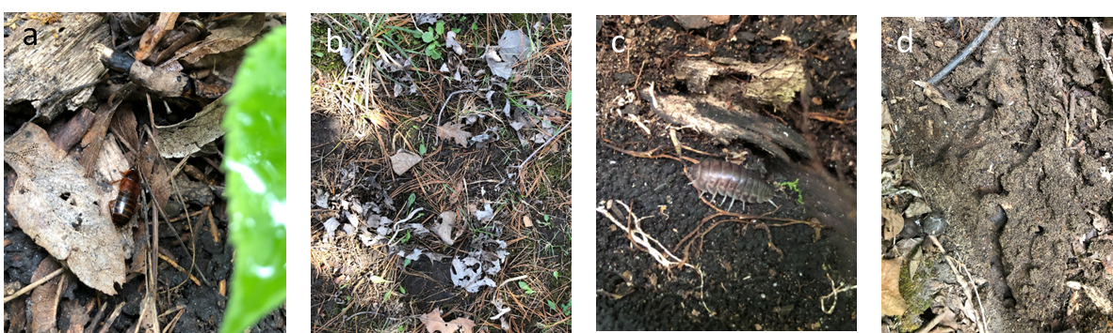
Soil Fauna/Biological Diversity Indicator
A ground beetle (a), earthworm midden piles (b), woodlouse (c), and ant burrow (d).
Notes:
Photo credits: Tom Sauer

Slide 35


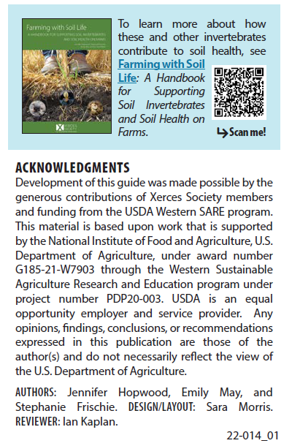
Soil Biota Resources
https://www.xerces.org/
Notes:
This indicator may be one of the more challenging for planners as it takes some specialized training or experience to be able to identify soil invertebrates and distinguish between beneficial and harmful species and populations. Use of additional resources like this Xerces publication or others may be helpful.

Slide 36
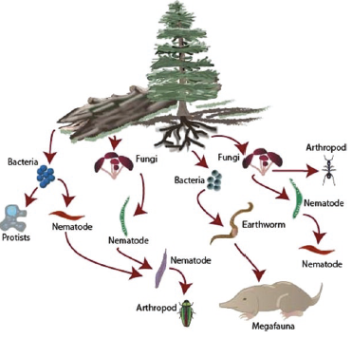
Forest Soil Biodiversity
Links between plant and soil organism biodiversity are unclear in U.S. forests
Intense harvesting and severe burning lead to greater impacts on species diversity and community structure
Wildfire, invasive animals and plants, and climate effects are difficult to generalize
Resistance = level of disturbance that a community can withstand before it is altered by that disturbance.
Resilience = rate at which a community returns to its original state
Yarwood et al., 2020.
https://doi.org/10.1007/978-3-030-45216-2_5
Notes:
Forest soil ecology is complex. In addition to differences related to forest type, soils, climate, and site history, and invasive species are creating new challenges for understanding the functioning of soil biota in forest ecosystems.
Yarwood, S. A., E. M. Bach, M. Busse, J. E. Smith, M. A. Callaham Jr., C. Chang, T. R. Chowdhury, and S. D. Warren. 2020. Forest and Rangeland Soil Biodiversity pp. 75-97 In: R. V. Pouyat et al. (Eds.) Forest and Rangeland Soils of the United States Under Changing Conditions. Springer Open. https://doi.org/10.1007/978-3-030-45216-2_5
Resilience much harder to determine.

Slide 37
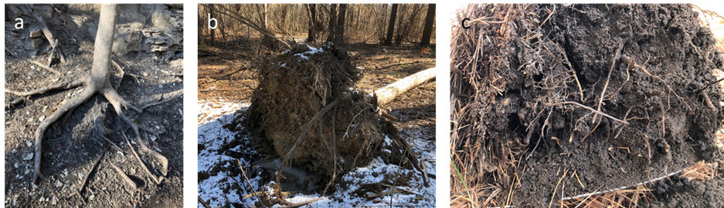
Roots Indicator
Tree roots exposed by loss of soil cover and soil movement (a), root mass of a pine tree windthrow (b), and prolific fine roots near the soil surface (c).
Notes:
Healthy roots without growth restrictions are key to healthy forests and forest soils. Root growth can be limited by restrictive layers of soil that are too dense, stony, or have chemical properties (salt, extreme pH) that prevent root growth. Shallow water tables can also restrict deeper rooting. Healthy roots also support soil biota as root exudates are an important source of organic compounds for building soil organic matter.
Photo credits: Tom Sauer

Slide 38
Tree Root Systems
Taproot
Heartroot
Flatroot
Spruce & Hemlock
Pine, Black Walnut, & Oak
Maple, Beech, & Fir
Wilde, S. A. 1958. Forest Soils – Their Properties and Relation to Silviculture. The Ronald Press Company, New York. 537 pp.
Notes:
Different tree species have characteristic root growth patterns. In general, trees that are better adapted to drier soils tend to have deeper roots.
Large roots are important for providing strength and stability so that the trees can remain standing in high winds. The fine roots are where most of the water and nutrients are absorbed.

Slide 39
Tree Roots
While trees have different rooting patterns, soil properties or restrictive layers may have a dominant effect on rooting depth and radius
Generally upland species are deeper rooted
Although tree roots have been measured to > 60 m(~200 ft!) most tree roots are found in the surface 60 cm (2 ft) of soil
Rough estimate of rooting radius = drip line
Consider effective depth = layer of depleted soil water
Stone, E. L. and P. J. Kalisz. 1991. https://doi.org/10.1016/0378-1127(91)90245-Q
Notes:
Stone, E. L. and P. J. Kalisz. 1991. On the maximum extent of roots. Forest Ecology and Management 46:59-102. https://doi.org/10.1016/0378-1127(91)90245-Q
A “rule of thumb” estimate is that tree roots extend at least to the drip line (diameter of tree crown projected down to the soil) and probably somewhat beyond.

Slide 40
FIFSHA Scoring and Interpretation
Notes:
The FIFSHA indicator scores are summed by RC. If a soil health RC is scored below the threshold value, then an RC is identified and implementation of conservation practices as part of a soil health management system is warranted.

Slide 41
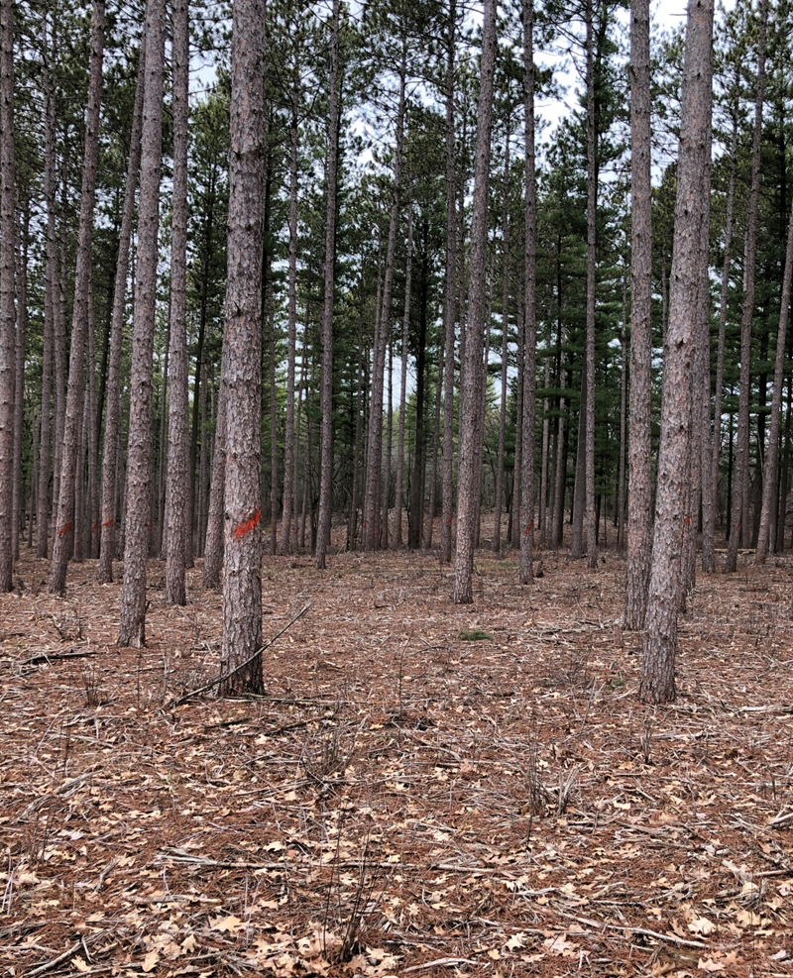
Applying the FIFSHA
An Example
Pine plantation
Kettle Moraine State Forest, South Unit
Waukesha County, WI
Notes:
Photo Credit: Tom Sauer
Pine plantation, Kettle Moraine State Forest South Unit, Waukesha County, Wisconsin.

Slide 42
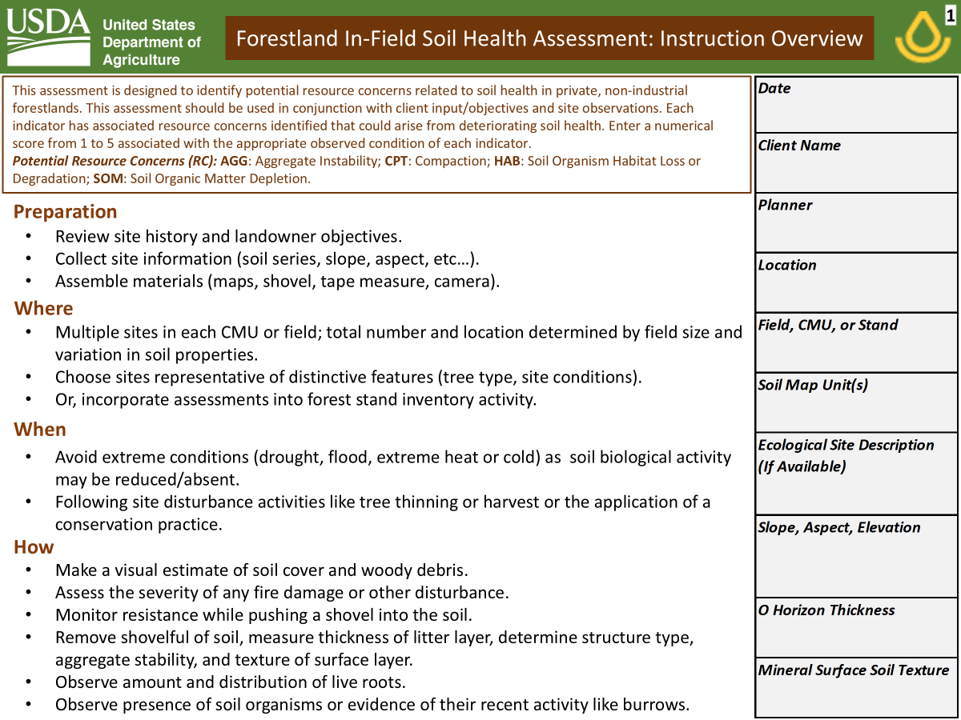
Site
Details
42° 56’ 30” N
88° 27’ 30” W
N of ZZ
Miami loam
Fox sandy loam
F095XB007WI
F095XB010WI
6%, SE
1”
sil
Notes:
Site details for the example location.
Miami loam: Fine-loamy, mixed active, mesic Oxyaquic Hapludalfs
Fox sandy loam: Fine-loamy over sandy or sandy-skeletal, mixed superactive, mesic Typic Hapludalfs
ESDs are provisional. Reference states are sugar maple, white ash, and basswood. Probably no longer relevant due to climate and emerald ash borer.

Slide 43
Surface Indicators
Surface nearly 100% cover
Masticated, same stage of decomposition
No evidence of fire damage
Skid steer tracks
Notes:
The site had invasive brush removed with a mechanical masticator leaving shredded mulch-like material on the soil surface. Some skid steer tracks were observed. The masticated material is of the same age and there was very littler other woody material on the forest floor and no CWD. There was no evidence of recent fire.

Slide 44
Soil
Indicators
Moderate resistance to spade insertion
Sink strainer test, aggregates partially disintegrate
Very limited biota
Moderate amount of roots
Notes:
Inserting a spade into the ground met with moderate resistance. Granular soil structure was observed at the soil surface with moderately strong subangular blocky structure deeper in the soil. Aggregates were observed to partially disintegrate with the sink strainer test.
Very limited biota were present in the soil and litter. Moderate amounts of roots were present.

Slide 45
Scoring and Interpretation
Notes:
If using the spreadsheet version, scores would sum automatically.
The FIFSHA indicator scores are summed by RC. If a soil health RC is scored below the threshold value, then an RC is identified and implementation of conservation practices as part of a soil health management system is warranted.

Slide 46
Summary
The goal of a Forestland In-Field Soil Health Assessment (FIFSHA) is to identify soil health resource concerns (RCs) on private non-industrial forestland agroecosystems.
The FIFSHA is designed to be broadly applicable and readily adaptable to local conditions and practices.
Eight indicators (Soil Cover, Woody Debris, Soil Burn Severity, Soil Disturbance Intensity, Soil Structure, Water Stable Aggregates, Soil Fauna/Biological Diversity, and Roots) are evaluated to identify whether any of the four soil health RCs (AGG, CPT, HAB, and SOM) are present.
Numerical ratings from 1 to 5 are used to determine whether
there is a Likely or Potential RC or whether there are No Apparent
RCs.
Notes:
The summary slide reiterates the important takeaways from the module. It is good to suggest that the FIFSHA can be adapted for local conditions and practices and, with experience, planners can calibrate their scoring to adjust for their observations of soil health RCs in their forestlands.

Slide 47
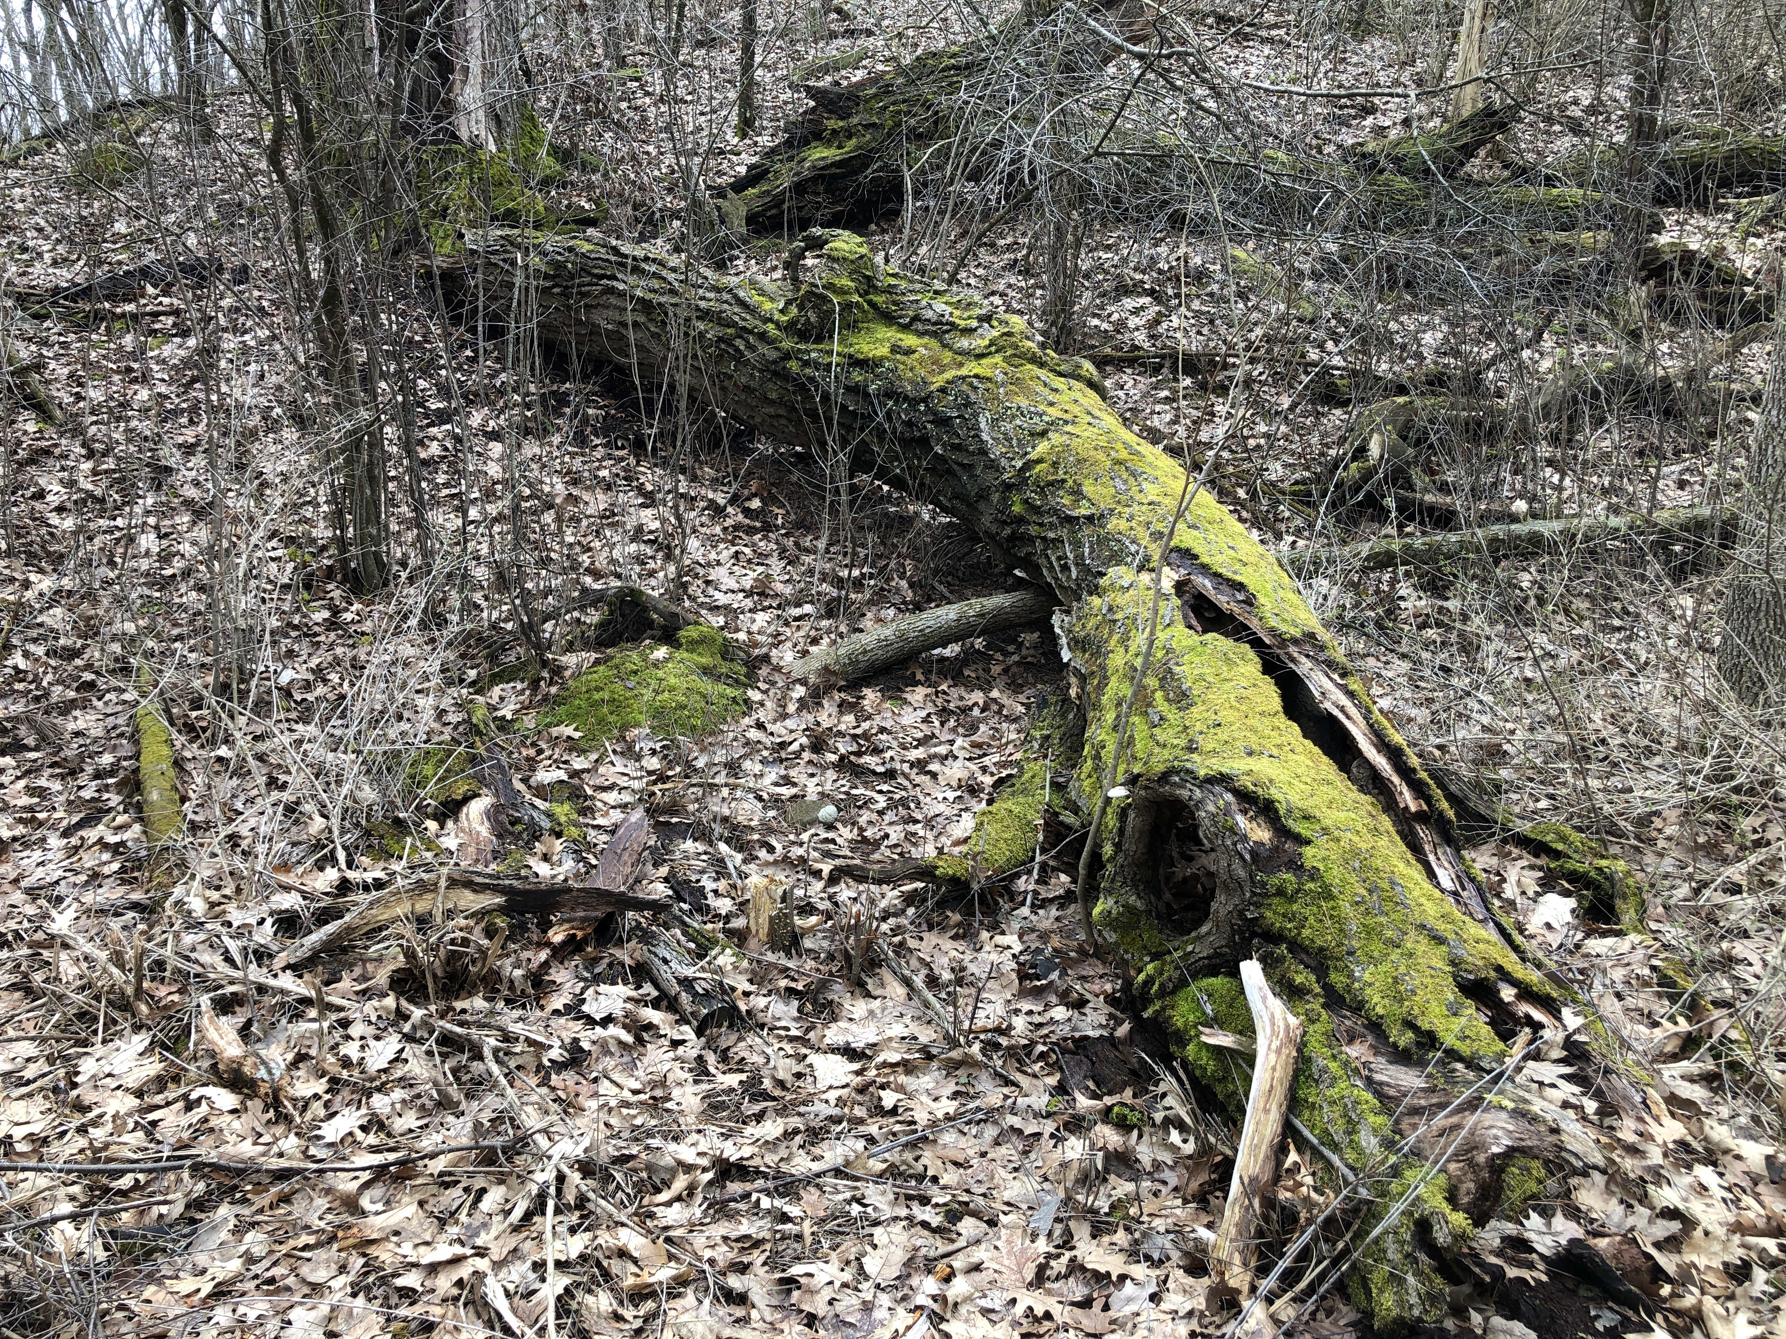
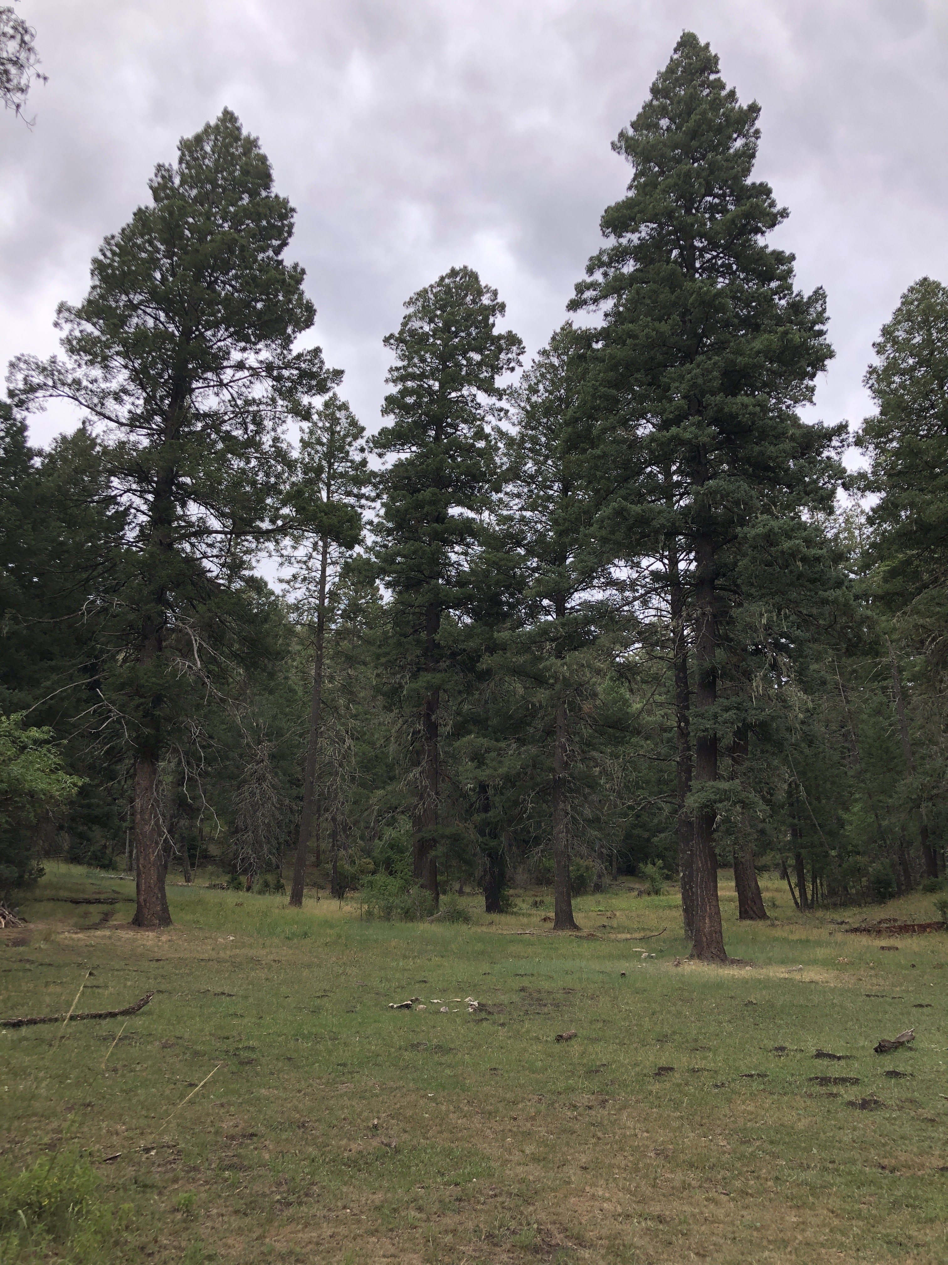
Questions?
Notes:
Ideally, there is sufficient time available for discussion and to address all questions.

Slide 48
Thank you!
For more information on Managing Soil Health,
visit us here:
https://www.nrcs.usda.gov/conservation-basics/natural-resource-concerns/soils/soil-health
USDA is an equal opportunity provider, employer, and lender.
Notes:
The presenter may wish to provide their contact information or that of a Soil Health Division staff member for any follow-up questions.

